Slide 1
Lending Club Case Study
Dillan Muthanna

Slide 2
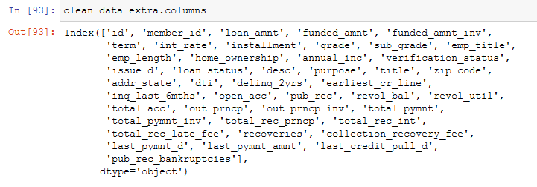
Cleaning columns
About 60 columns out of 111 were full of null values.
A few had redundant columns and had to be removed (eg initial_list_status, application_type, policy_code etc )

Slide 3
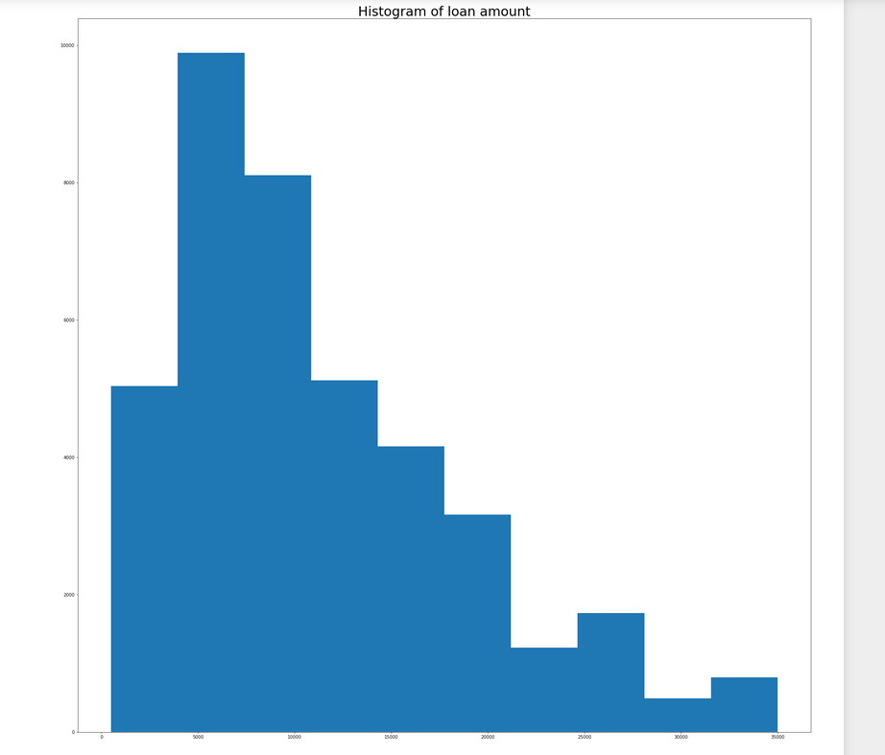
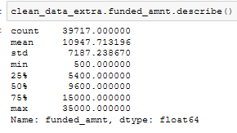
Lets Understand the distribution of loan amount

Slide 4
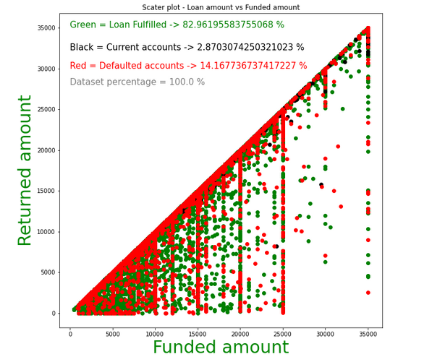
Understanding trend trend in users

Slide 5
Insights
Dataset is valid , there is no single instance where returned amount is greater than funded amount
Funds are generally given around 500 range starting from 0 to 3500
82 percent of users are good users who repay on time , only 14 percent are defaulters

Slide 6
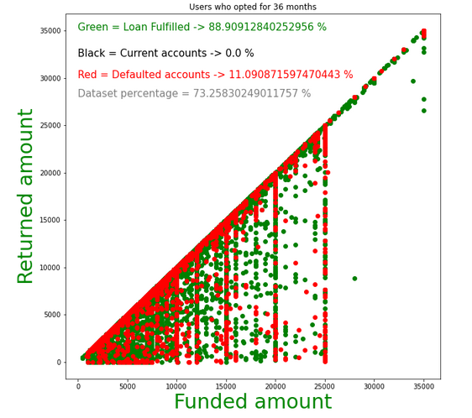
Understanding trend in different terms 36 months vs 60 months

Slide 7
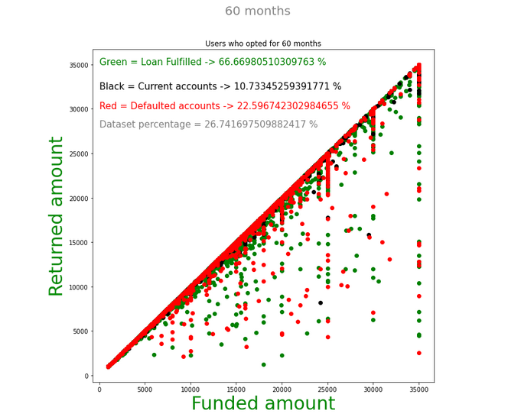

Slide 8
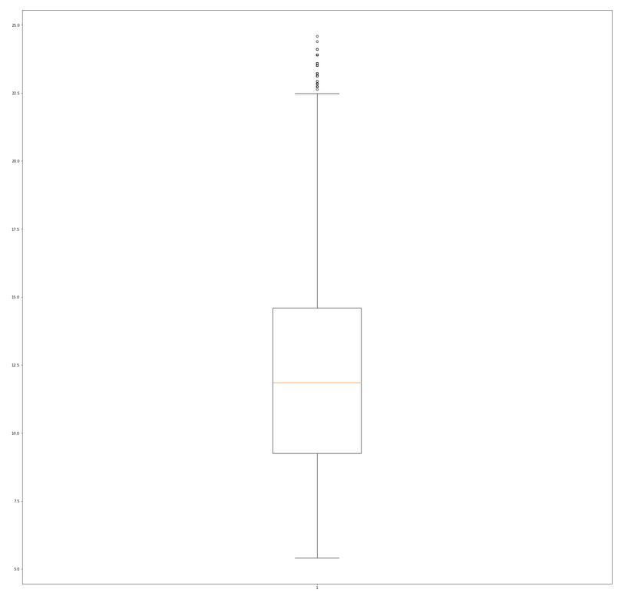
Interest rate
Defaulters are more in 60 months as opposed to 36 months
Maybe people get bored and lazy paying loans in the long term !
interest rate range between 5 and 24 also we have outliers above 22.5 , we need to get rid of those if we plan to use any classification algorithm)

Slide 9
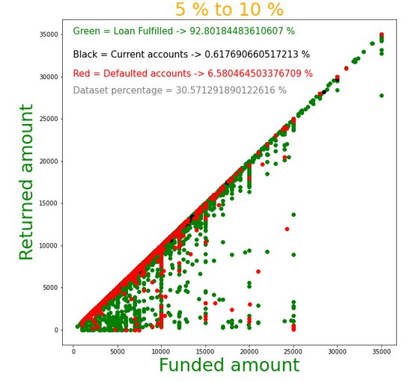
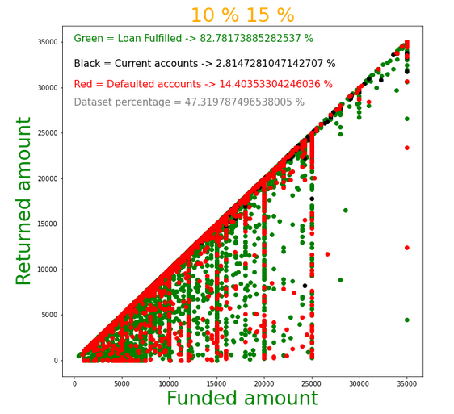

Slide 10
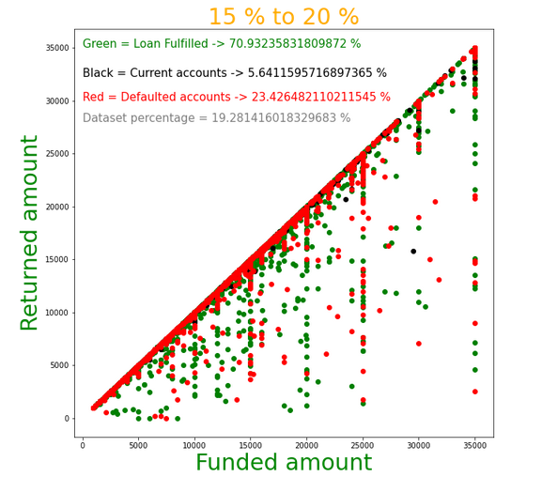
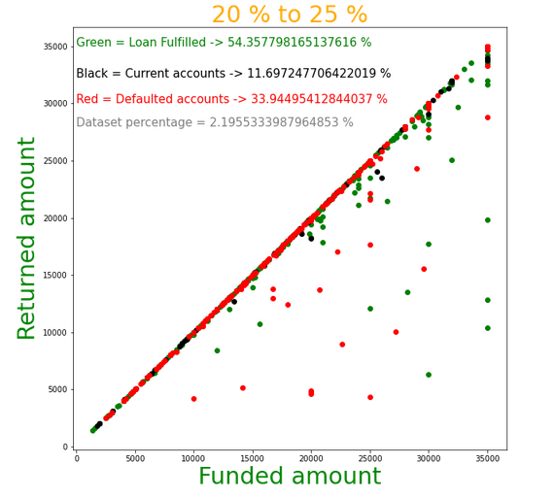
As the interest rate increases, the number of defaulters is also increasing

Slide 11
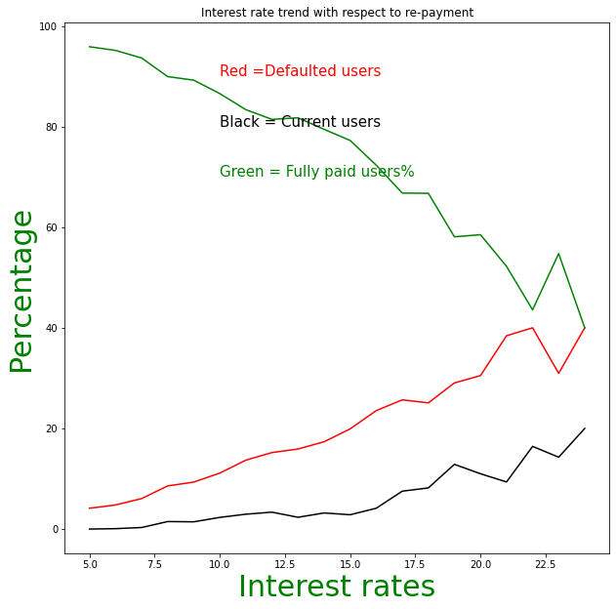

Slide 12
interesting mirror like trend between fully paid accounts and defaulters. at low interest rates people are able to easily repay loans
anomoly observed above 22.5 could be due to outliers in the dataset as found earlier

Slide 13
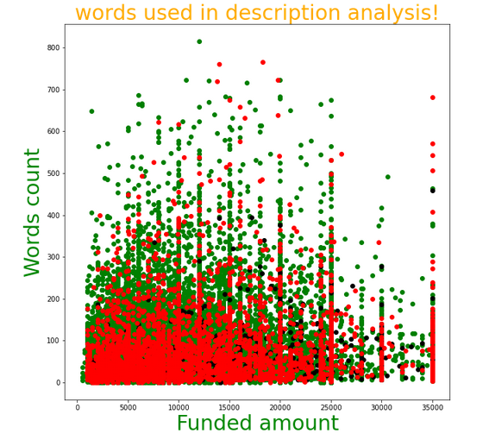
Interesting to see that people who usually describe in detail why they need the loan have high probability of repayment

